Slide 1
Brain and sugar
Adi benito, M.D.
Suppers Board of trustee

Slide 2
Concepts to explore
Introduction
Sugar effect on brain function
Sugar effect on mood
Sugar and cravings
Sugar toxicity
Artificial sweeteners
Strategies

Slide 3
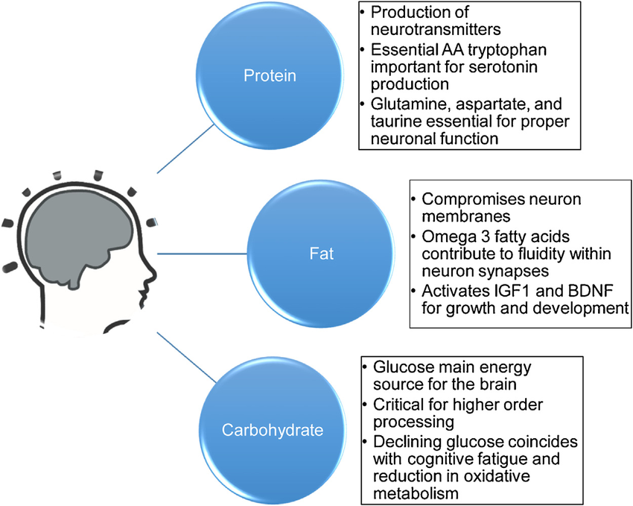
Introduction
Our brains need fuel for functioning; this fuel comes from protein, healthy fats, and carbohydrates (sugars).
Carbohydrates turn into glucose (blood sugar) to fuel our brain; and are a great source of energy and some neuroactive compounds (e.g., glutamate, aspartate, glycine, D-serine).
Not all carbohydrates are created equal:
Simple carbohydrates such as sweet and processed foods with added sugar (including table sugar, HCFS, honey and others) are rapidly digested/broken down into glucose (and also into fructose)
Complex carbohydrates include those that are rapidly digested/broken down (white bread, potatoes, white rice, bananas, pasta) and those slowly digested or not digested at all (whole grains, beans/legumes, non-starchy vegetables such as broccoli, Brussel sprouts and kale, bell pepper, raw spinach, zucchini, asparagus).
In conclusion: our brain needs carbohydrates, not added sugars

Slide 4
Sweet foods/simple carbohydrates
Our brains have learned that sweet foods are rarely toxic
Sweet foods trigger our brains to activate the brain “reward” system by releasing dopamine which makes us look for/want sweet foods and give us a rewarding feeling (we feel good)
Overtime this reward system needs more sweets in order to get the same response
To suppress the urge to eat more sweets, our brain impulse control must work properly by releasing GABA

Slide 5
Sugar and Cravings/hunger
A diet high in sugar blocks the impulse control center of the brain
Sugary foods and drinks, white bread and other rapidly broken down carbohydrates can cause abrupt spikes and falls in blood sugar and stimulate brain centers involved in hunger and cravings.
When our blood sugar levels drop we lose our ability to control desire and feel an increased urge to eat.

Slide 6
Sugar and Brain
High blood sugar can lead to decreased brain connectivity
A diet high in sugar lowers the production of new brain cells affecting memory and cognition/ learning
High blood sugar has been linked to lower scores on cognitive tests and dementia
A diet high in sugar has been linked to inflammation and problems with memory
In the long term, high blood sugar and diets high in sugar cause brain shrinkage, and decrease blood flow to the brain, leading to diseases of the brain such as dementia/Alzheimer’s
Notes:
N. Cherbuin, P. Sachdev, K. J. Anstey. Higher normal fasting plasma glucose is associated with hippocampal atrophy: The PATH Study. Neurology, 2012; 79 (10): 1019 DOI: 10.1212/WNL.0b013e31826846de

Slide 7
Sugar and mood
A diet high in sugar has been linked to depression and anxiety
Eating sugary foods can cause sudden spikes and drops in blood sugar levels and these sudden changes make us more irritable, anxious, and depressed.
Eating sugary foods leads to cravings and hunger

Slide 8
Sugar and body
A diet high in sugar (especially sugar-sweetened drinks) leads to
Tooth decay
Acne
Obesity
Diabetes (type 2 or “adult-onset”)
Risk of dying of heart disease

Slide 9
Diet high in Sugar-how it is toxic
High levels of blood sugar triggers our body to make “glycation molecules” (toxic blood chemicals) which are inflammatory (think “sticky”) to small blood vessels, the brain and nerves, and the heart, even the small blood vessels in the brain.
Consumption of fructose (the “sugar” in syrups, honey, soft drinks, sweetened fruit yogurt, pies, sauces and dressings and fruits) and sugar (table sugar, processed foods) have been linked to increased inflammation
High blood sugar can lead to low immunity (frequent infections) and fatigue.

Slide 10
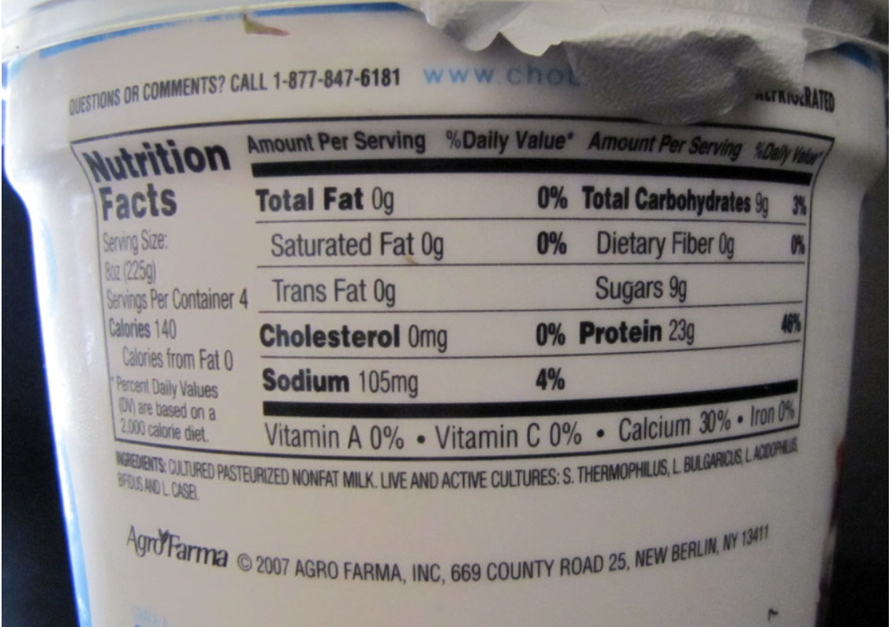
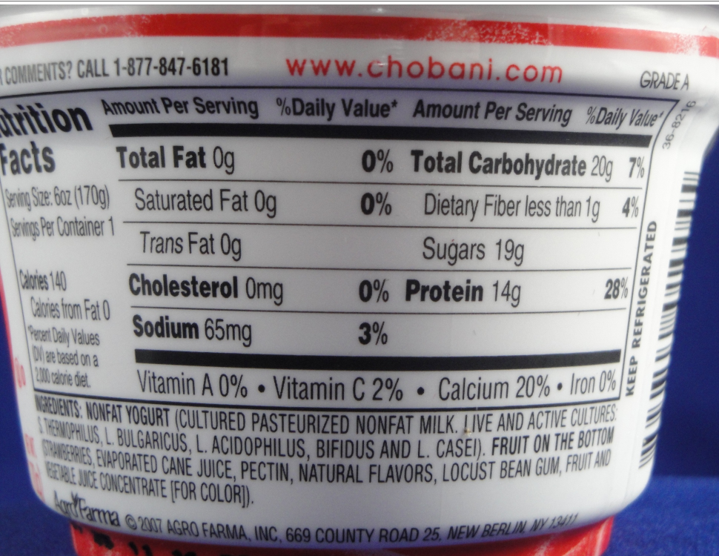
Sugar in Numbers
No actual recommendations for added sugars
Suggestions for sugar intake by the American Heart Association:
6 teaspoons (25 grams) per day for women
9 teaspoons (38 grams) for men
3-6 teaspoons (12-25 grams) for a child
Current average sugar consumption in the USA is 17 teaspoons per day
One 12 oz. soda contains 11 teaspoons (46.2 grams) of added sugar
1-2 sugary drinks per day leads to 5 extra years of aging (memory)

Slide 11
Reading food labels-if you must (names for added sugar)
Brown sugar
Corn sweetener
Corn syrup
Fruit juice concentrates
High-fructose corn syrup
Honey
Invert sugar
Malt sugar
Molasses
Syrup sugar molecules ending in "ose" (dextrose, fructose, glucose, lactose, maltose, sucrose).

Slide 12
Artificial Sweeteners: A warning
Artificial sweeteners in diet products
Artificial sweeteners are sweeter than natural sweeteners but lack the calories.
Artificial sweeteners do not cause more weight loss compared to natural sweeteners. In some studies diet soda consumption was even associated with weight gain.
Artificial sweeteners do not activate food reward pathways in the same fashion as natural sweeteners. In artificial sweeteners there is a lack of calories after the sweet taste, which may result in compensatory overeating
Artificial sweeteners have been linked to a higher risk of stroke and dementia

Slide 13
Sugar and Cravings-Help is on the way
Limit sugar to 25 grams per day (6 teaspoons) if a woman; 38 grams (9 tsp) if a man; 12-25 grams (3-6 tsp) for a child
Avoid artificial sweeteners
When eating carbohydrates (simple and rapidly broken down carbohydrates), eat fiber and protein at the same time, to keep you feeling fuller and avoid swings in blood glucose
Exercise protects the brain from the effects of too much sugar; yoga increases dopamine
A healthy breakfast with a good amount of protein reduces cravings and increases dopamine
Foods rich in tyrosine (a precursor to dopamine) might help: apples, bananas, berries, avocados, nuts (almonds and walnuts), lima beans, seeds (pumpkin, sunflower and sesame), beets and artichokes.
Find other healthier ways to stimulate the reward system (social connections)
Get a good night’s sleep. Recent data has shown that lack of sleep is associated with more hunger and preference for salty snacks and sweet and starchy foods.

Slide 14
Brain reprogramming
Our brain can be reprogrammed (neuroplasticity)
Inflammation might not be permanent
Memory can improve by decreasing the amount of sugar
Ensure healthy omega-3 fatty acids (Cold water fish/seafood (sardines, salmon, oysters, anchovies, mackerel), seeds and nuts (walnuts, chia, flax), grass-fed meats. eggs (pastured and enriched varieties), spinach, Brussel-sprouts, soy-beans
Add turmeric to foods or use as tea
Create new dishes

Slide 15
Sugar Cravings-Help is on the way (cont.)
Introduce bitter foods such as arugula, broccoli rabe, endive, escarole, radicchio and dandelion. If these are unappealing to you, gymnema is an herb that can be used as a supplement to curb sugar cravings. Sour foods might help as well (hibiscus tea-minus the sugar-, pickles, lemon).
Eat foods rich in GABA, such as cruciferous vegetables, peas (sprouted better), tomatoes, spinach, mushrooms (shiitake), sprouted grains and beans (adzuki), brown rice, oats, barley, and chestnuts. Also, enjoy fermented foods such as kefir, yogurt, miso, tempeh, kombucha and white teas rich in GABA

Slide 16
Ketogenic diet
Mimics starvation
80-90% fat, normal protein, low carbohydrates (4:1 fat:protein; with variations 3:1; MCT; modified Atkins; low-glycemic index diet)
Fasting and starvation make the body produce ketones, which can enter the brain
Neuroprotective
Drug-resistant epilepsy in children (good data)
Traumatic brain injury?
Alzheimer’s disease (some data of MCT added to a normal diet)
Parkinson’s disease, stroke, ALS (preliminary data promising)
Side effects:
Short term: Constipation, dehydration, vomiting, nausea, low blood sugar
Long term: kidney stones, bone fractures, high cholesterol
Consider an intermittent schedule

Slide 17
Summary
Our brain needs nutrients including healthy sugars, but not added sugars
Sugar in excess creates hunger, cravings for more sugar and is toxic to the brain
Sugar in excess leads to brain shrinkage and dementia and is associated with depression
Sugary foods create a rollercoaster of sugar levels and mood changes (anxiety, irritability)
Eat healthy carbohydrates, ensure enough fiber and protein (including at breakfast)
Use food as medicine (high in Dopamine and high in GABA)
Exercise/yoga, sleep and social connections equally important

Slide 18
The Problem with Fructose
Quantity (25-40 g/d)
Content
Undisclosed in labels

Slide 19
Fructose and Fiber in Fruits and vegetables
Note that foods on the lower part of the screen have lower fructose and foods on the right part of the graph have more fiber
So, ideally eat foods on the lower part and to the right (avocado is the winner!)
Even at its highest amount of fructose, grapes do not pack as much fructose as fruit juices or sodas,
Although you might see as much fructose (or more) in one cup of pears as in a slice of pie as; fruits have the added benefit of minerals, vitamins, fand anti-inflammatory compounds.

